Slide 1
Rainbarrel
Pitched by: Timothy van der Steenhoven Team: Saskia van der Velden
Emmanuel Bakare
Timothy van der Steenhoven

Slide 2


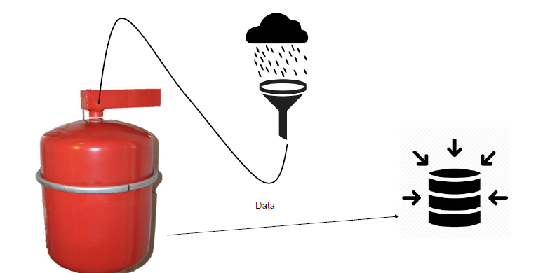
Materials + application
Notes:
Sewertax -> Every year +2%
New-> RainwaterTax. Especially in Amsterdam

Slide 3

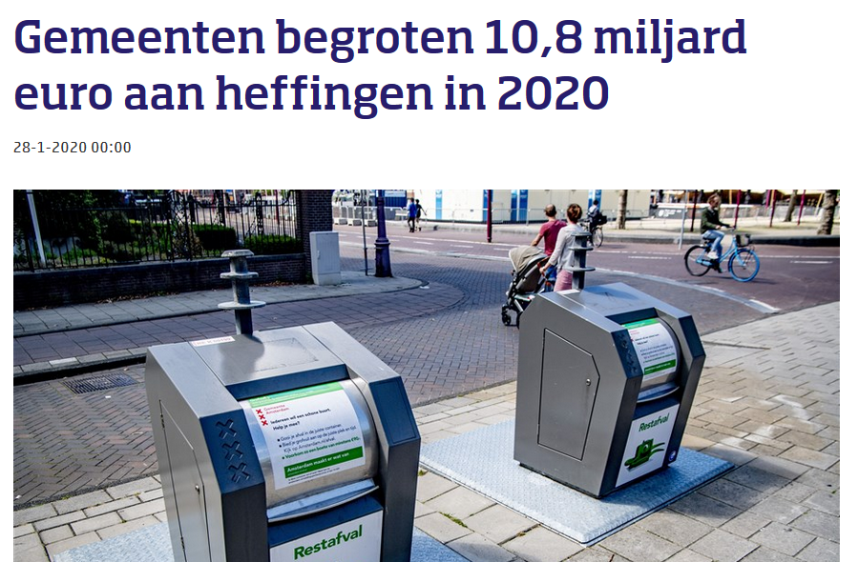
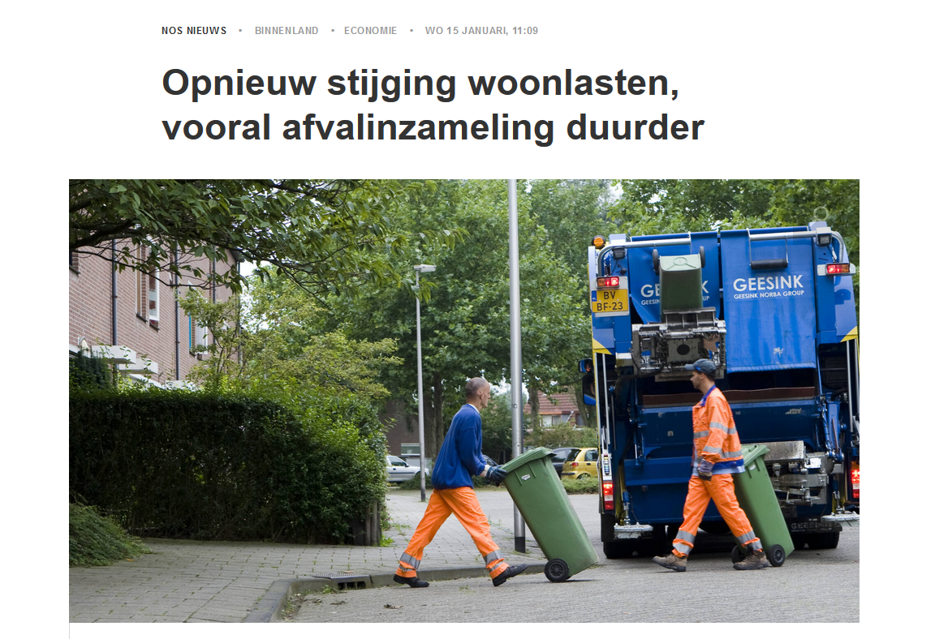
Why is this useful?
Notes:
Sewertax + 2% every year Some city’s (Amsterdam) have a rainwater regulation policy.
Every new building has to have some sort of rainwater system.

Slide 4

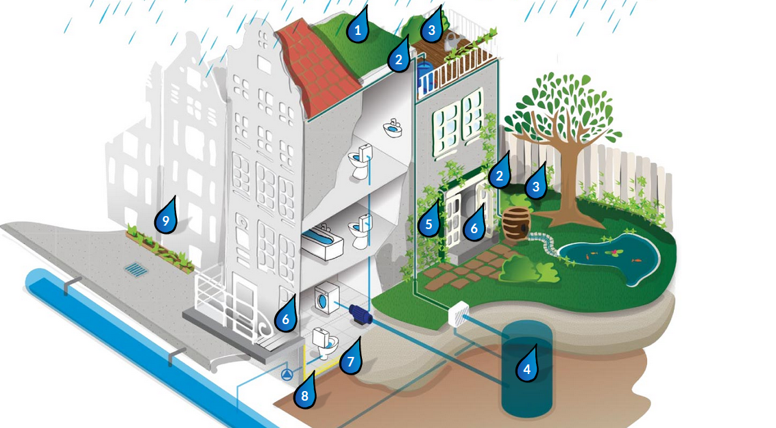
https://www.rainproof.nl/wat-kan-ik-doen/gebouw

Slide 5
Where can it be applied?
owner-occupied home
rental house
Industrial

Slide 6

Who will use it?
renovation companys
housing corporations
Conscious home owners
Notes:
2016 -> 2050 the Netherlands is waterrobust
At the moment there is no subsidy by a government organ for using water saving measures

Slide 7
Who will buy it?
People who are renovating their homes
Housing Corporations
Notes:
One of the easy selling points of this product is its simple mechanism. It reuses a difficult material into something it was made to do: Containing water and reusing it when needed.

Slide 8
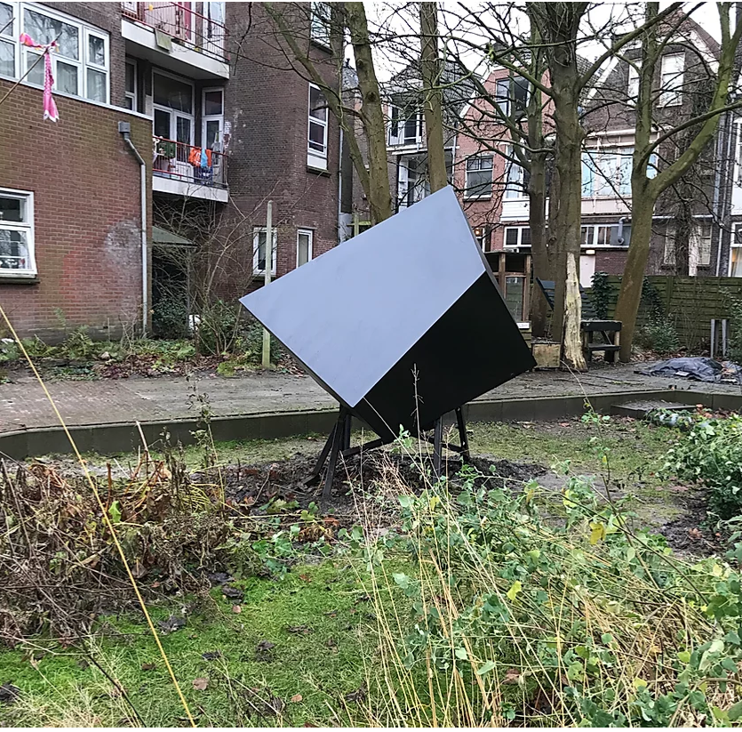
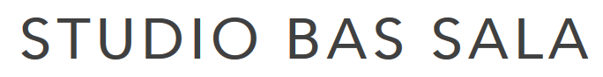
Who can make this?

